Slide 1

Revolutionizing Hydration with Smart Technology
Devakrishnan
Presenter
Introducing AquaTrack, a pioneering company dedicated to enhancing hydration practices through advanced technology, empowering individuals to embrace healthier lifestyles.

Slide 2
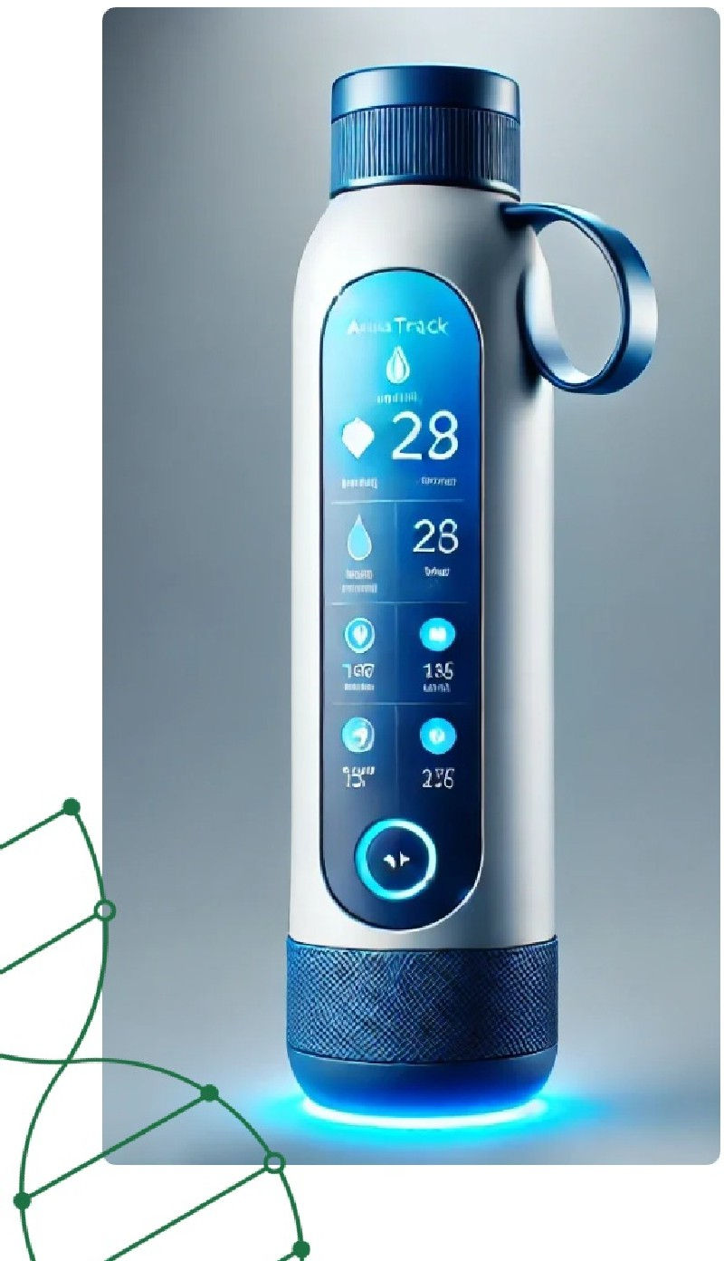
Introduction to AquaTrack
Empowering Health Through Innovative Hydration Solutions
&
Investor Pitch for AquaTrack
AquaTrack aims to attract investors with innovative hydration solutions.
Overview of AquaTrack
Revolutionizing hydration with cutting-edge smart technology solutions.
The Smart Hydration Revolution
Harnessing technology to enhance hydration habits for better health.
Welcome and Introduction
A warm welcome to introduce AquaTrack's vision and mission.
Mission Statement
To empower individuals to stay hydrated and lead healthier lives.

Slide 3
Challenges in Maintaining Hydration
Exploring the Barriers to Optimal Hydration
Forgetting to Drink Water Regularly
Many individuals neglect to drink water throughout the
day, impacting their hydration levels.
Lack of Tools for Tracking Hydration
There is a scarcity of effective tools available that help users monitor their daily water intake.
Health Impact of Dehydration
Dehydration can lead to decreased energy, poor focus,
and overall health decline.
Growing Interest in Health Tech
There is an increasing demand for health-focused products that integrate technology for better hydration.

Slide 4
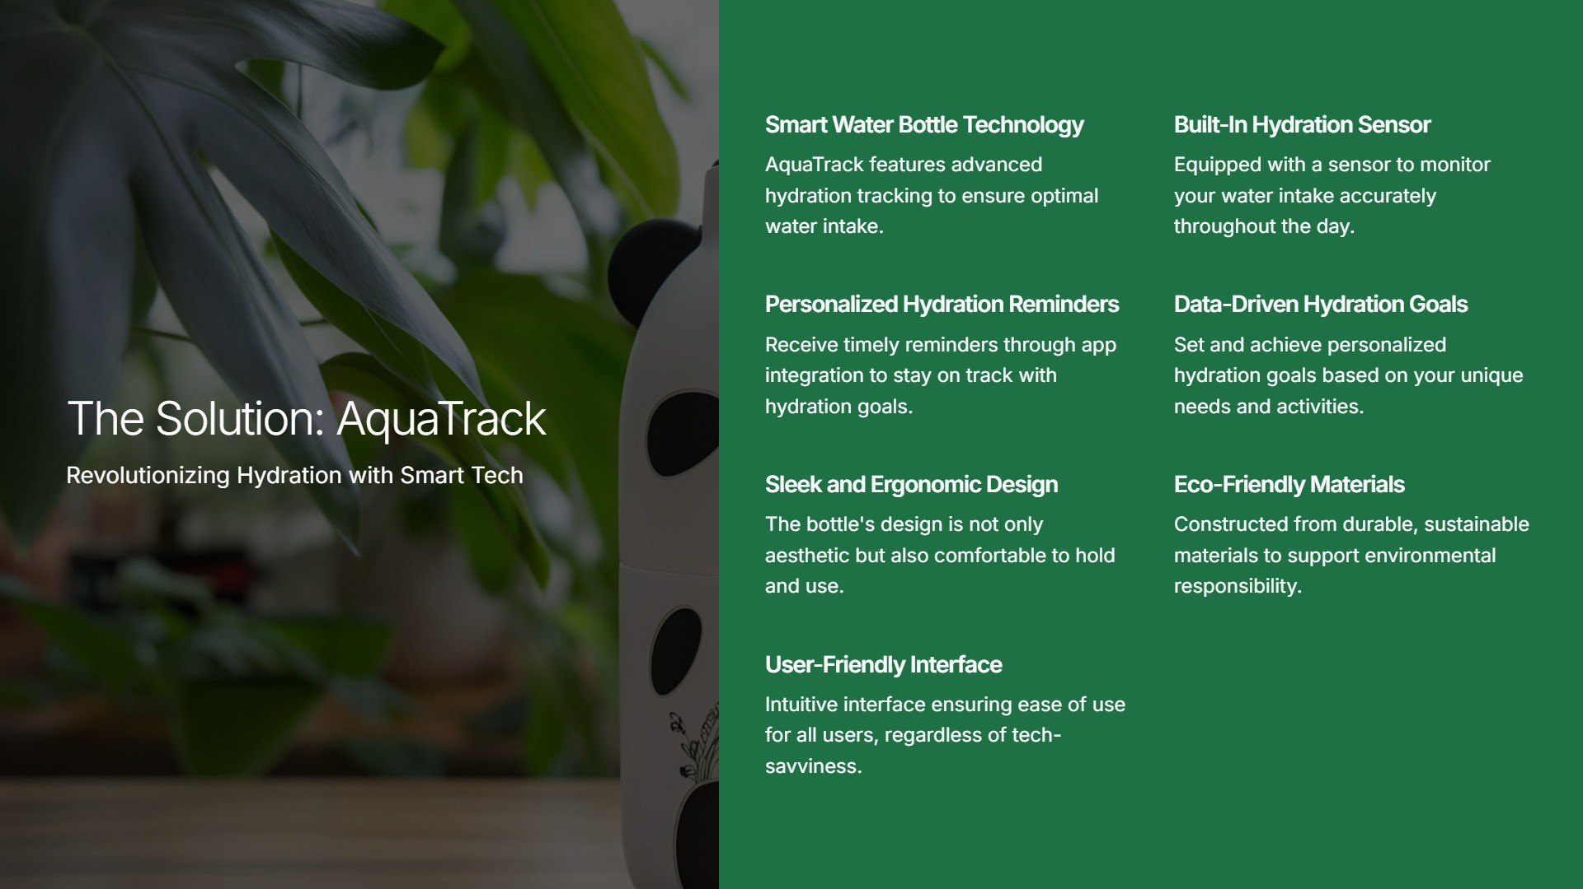

Slide 5

Exploring Market Opportunities in Health Tech
Understanding the Growing Demand for Wellness Technology
■
■
II
Global Health and Wellness Growth
The industry is experiencing a significant rise in demand for tech­ driven fitness and wellness products.
Iii
Target Market Segments
Identifying key demographics: fitness enthusiasts, health­ conscious professionals, and busy individuals.
Fitness Enthusiasts
This segment actively seeks innovative fitness solutions to enhance their workout routines.
■
■
Health-Conscious Professionals
Professionals who prioritize health and wellness in their daily lives, often looking for convenient solutions.
Busy Individuals
People with hectic schedules looking for convenient and efficient wellness products.
Market Size for Smart Hydration
Projected market size for smart hydration products is expected to reach $X billion by 20XX.

Slide 6

Comprehensive Business Model Overview
Revenue Streams
We generate revenue through direct sales, partnerships, and subscriptions.
Direct-to-Consumer Sales
E-commerce platforms enable us to sell directly to consumers, maximizing profit margins.
Partnerships with Fitness Centers
Collaborations with fitness and wellness brands expand our reach and enhance brand visibility.
Exploring Revenue Streams and Pricing Strategy
Subscription-Based Features
Advanced analytics through our app via subscription enhances user engagement and retention.
Pricing Strategy
We adopt competitive pricing while offering premium features to attract diverse customer segments.

Slide 7


Strategic Marketing & Growth Plan
Comprehensive Approach for Brand Development
Establish a tech-savvy, health-focused, and eco­
Partner with fitness apps and wellness influencers to boost brand visibility.
Collaboration with Influencers
[---■
friendly brand image.
Branding and Positioning
Awareness Campaigns
Implement digital marketing strategies like social media ads and influencer collaborations.

Slide 8

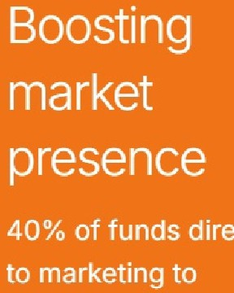

Comprehensive Financial Projections
Projected revenue, break-even timeline, and funding strategy
••
40% annual
30%forR&D
revenue growth
X months to break-even
Investment in
innovation
Allocating 30% of
funding to R&D to
enhance product
development and
competitiveness.
30% for Scaling
and Operations
Steady
growth
Operational
Quick return on investment
Projected to reach break-even within X months, promising swift financial recovery.
anticipated
efficiency
The revenue is
expected to grow by
focus
40% annually,
indicating a strong
30% allocation for
market demand.
strengthen brand
scaling operations
ensures efficient
growth management.

Slide 9
Why Invest in AquaTrack for Future Growth?
Discover the advantages of investing in AquaTrack's innovative approach
Strong Market Opportunity
The water management sector is expanding
rapidly, driven by increased awareness of
water scarcity and demand for efficient
solutions.
Growing Demand for
Unique Product Features
Innovation
AquaTrack offers unique tracking capabilities
that provide users with real-time data on
Consumers are seeking innovative products
their water consumption.
that enhance their water usage efficiency
and promote healthy living.
Scalable Business Model
The business model is designed for
scalability, ensuring high return on
investment potential as the customer base
grows.
Commitment to Sustainability
AquaTrack prioritizes sustainability, ensuring
that our products contribute to environmental
health and customer well-being.
Customer Health Focus
Our products not only optimize water usage
but also promote healthier choices for users,
enhancing their overall quality of life.

Slide 10

Q&A and Closing Remarks
Engaging audience with questions and contact details

